Slide 1
Capstone Project
Codejob
Aalok Thakkar - Group Leader
Bhagya Majithiya
Farhan Ansari
Rajan Chauhan

Slide 2
Problem
Develop a spell checker application that checks the spelling of words in a given text document, utilizing data structures like hash tables or trie for efficient dictionary storage and lookup. After highlighting the misspelled words, with the user’s approval, replace them with the correct spellings.

Slide 3
Algorithm
The solution we present is based on the errors that may be present within a wrong spelling which include
Missing character
Extra character
Exchanged character
Incorrect arrangement
We created functions to resolve each of these errors and stored the potential correct word within a list and let the user choose the correct word and make appropriate changes.
We also give the user option to either write a string at the moment or upload a document with a sequence of strings.

Slide 4

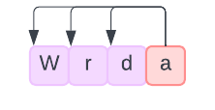
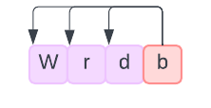
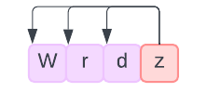
Missing character function
Append alphabet to the incorrect word
2. Permute the alphabet to every position
3. Append every alphabet likewise and store the correct words within a list

Slide 5
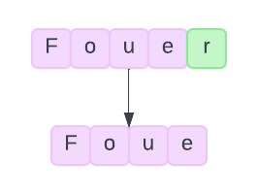
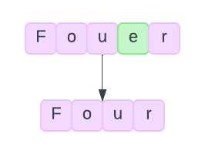
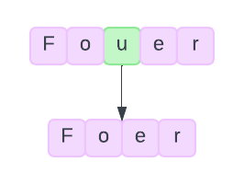
Extra character function
Deleting every character of the word one by one to find the correct word

Slide 6
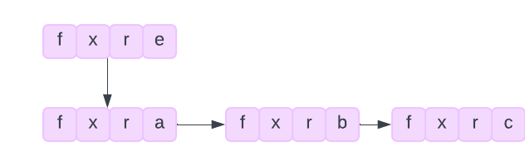
Exchanged character function
Replace every character with all the alphabets and checking for correct words

Slide 7
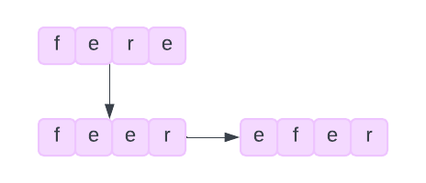
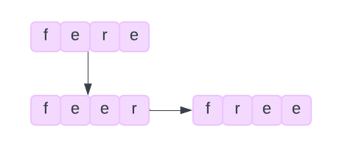
Incorrect arrangement function
Permute the string to create all the possible combination of the incorrect word

Slide 8
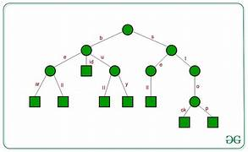
Data structures we used and why?
1. Trie: Used for storing the dictionary because when compared to hash tables, Trie is more
efficient in storing and searching for elements stored within.
2. Queue :We used Queue because insertion in queue is easy and it works on first in first out
which tackles the problem of string reversal.
3. Doubly linked list: Used to store correct spelling of incorrect words as searching and
retrieving data within a given link is more efficient than other linear data structures.

Slide 9
Time complexities
Trie data structure:
Insert function - O(logn)
Search function - O(k), k is length of the biggest word
Missing character function - O(nlogn)
Extra character function - O(nlogn)
Incorrect arrangement function - O(n! logn)
Exchanged character function - O(nlogn)

Slide 10
Space complexities
Missing character function - O(N)
Extra character function - O(N)
Incorrect arrangement function - O(N)
Exchanged character function - O(N)
N is the length of the input string

Slide 11
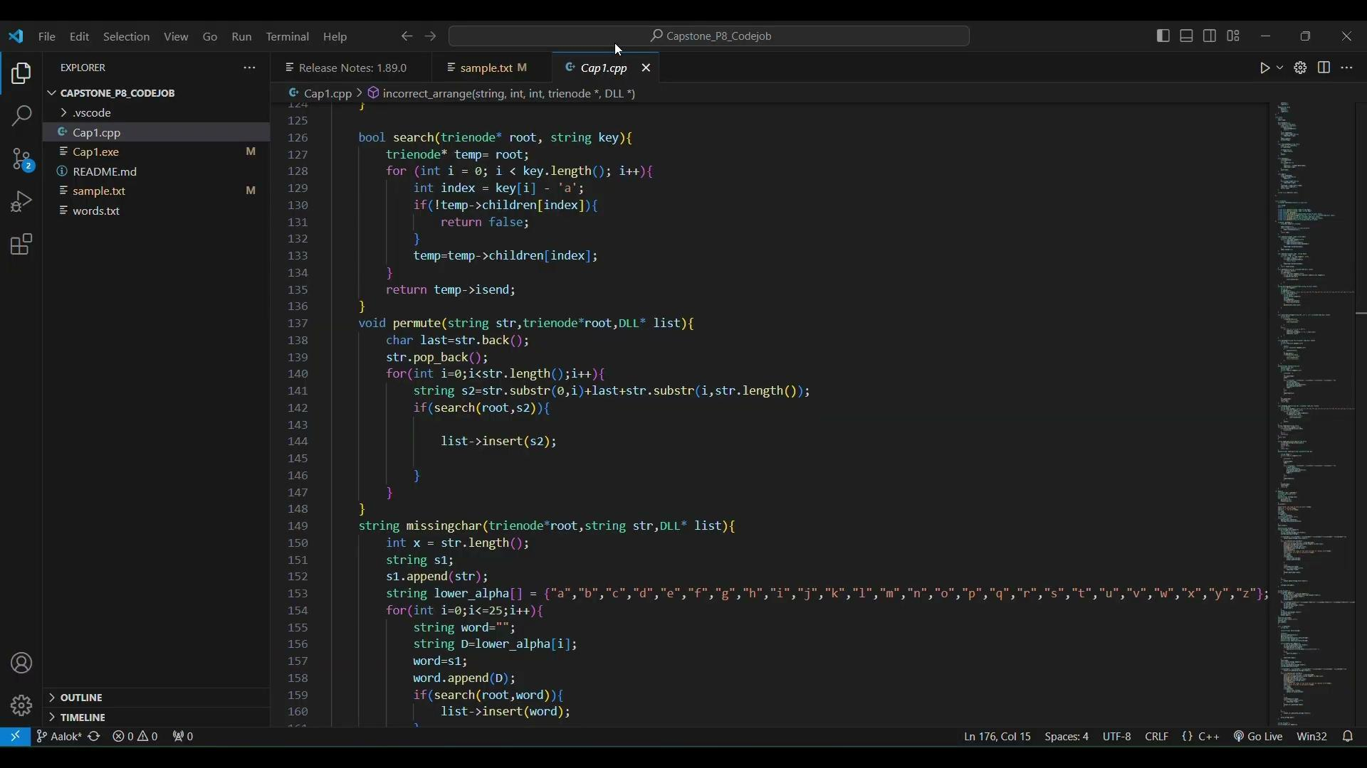
Video recording of the code with voiceover

